Slide 1
ADVANCED WEB TECHNOLOGIES UNIT – III
Shreya J Shetty
Assistant Professor Gd – I
Department of MCA

Slide 2
Origins
JavaScript was developed by Brendan Eich at Netscape.
It was initially called Mocha, then renamed LiveScript, and finally JavaScript in 1995.
JavaScript was standardized by ECMA International as ECMA-262.
It was also approved by International Organization for Standardization as ISO-16262.
The official name of the standard language is ECMAScript.
Microsoft developed its own version called JScript.
JavaScript has three parts: Core, Client-side, and Server-side.
Client-side JavaScript is embedded in HTML and is used to handle user interactions like mouse clicks and keyboard input.

Slide 3
JavaScript and Java
One important difference is support for object-oriented programming. Although JavaScript is sometimes said to be an object-oriented language, its object model is quite different from that of Java and C++
Java is a strongly typed language.
Variables in JavaScript need not be declared and are dynamically typed
Another important difference between Java and JavaScript is that objects in Java are static and objects in JavaScript is dynamic
The main similarity between Java and JavaScript is the syntax of their expressions, assignment statements, and control statements.

Slide 4
Uses of JavaScript
JavaScript was originally designed for both client-side and server-side programming.
It has evolved into a full-fledged programming language used in many application areas.
Client-side JavaScript helps reduce server load by performing computations in the browser.
It is embedded in HTML and executed (interpreted) by the browser.
Client-side JavaScript cannot handle file operations, database access, or networking, unlike server-side languages.
It is widely used for user interaction, such as handling buttons, forms, menus, and mouse/keyboard events.
With the Document Object Model (DOM), JavaScript can modify HTML content and styles dynamically, making web pages interactive.
JavaScript is event-driven, meaning actions are triggered by user activities like clicks, mouse movements, and form submissions.

Slide 5
Browsers and HTML–JavaScript Documents
If an HTML document does not contain any scripts, the browser simply reads each line and displays the content based on the tags, attributes, and text present.
When the browser comes across a JavaScript code, it uses its JavaScript interpreter to execute the script.
The output produced by the script is treated as new content and displayed in the browser. After executing the script, the browser continues reading the remaining HTML and renders it.
There are two ways to include JavaScript in an HTML document:
Explicit embedding – The JavaScript code is written directly inside the HTML file (in the head or body section).
Implicit embedding – The JavaScript code is stored in a separate file and linked to the HTML document.

Slide 6
2 Object Orientation and JavaScript
As stated previously, JavaScript is not an object-oriented programming language. Rather, it is an object-based language.
JavaScript does not have classes.
Despite the fact that JavaScript is not an object-oriented language, much of its design is rooted in the concepts and approaches used in object-oriented programming.
const person = { firstName: "Jane", lastName: "Doe", age: 30, isStudent: false, hobbies: ["reading", "hiking", "cooking"], address: { street: "123 Main St", city: "Anytown", zipCode: "12345" }, greet: function() { console.log(`Hello, my name is
${this.firstName} ${this.lastName}.`); } };
// Accessing properties using dot notation console.log(person.firstName); // Output: Jane console.log(person.address.city); // Output: Anytown // Accessing properties using bracket notation (useful for dynamic keys) console.log(person["lastName"]); // Output: Doe // Calling a method person.greet(); // Output: Hello, my name is Jane Doe.

Slide 7
2.1 JavaScript Objects
In JavaScript, objects are collections of properties
Each property is either a data property or a function or method property.
Data properties appear in two categories: primitive values and references to other objects.
All primitive values in JavaScript are accessed directly—these are like the scalar types in Java and C++.
The properties of an object are referenced by attaching the name of the property to the variable that references the object. - myCar.engine. (myCar is object and engine is a property)
A JavaScript object appears, both internally and externally, as a list of property–value pairs.
The properties are names; the values are data values or functions.
All functions are objects and are referenced through variables.
The collection of properties of a JavaScript object is dynamic: Properties can be added or deleted at any time during execution.

Slide 8
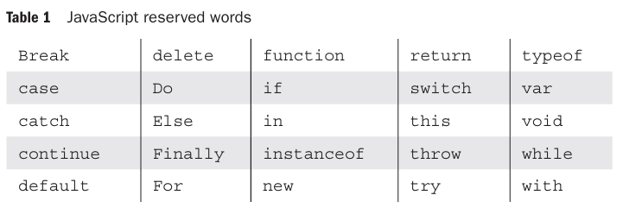
3 General Syntactic Characteristics
Scripts can appear directly as the content of a <script> tag. The type attribute of <script> must be set to "text/javascript".
The JavaScript script can be indirectly embedded in an HTML document with the src attribute of a <script> tag
<script type = "text/javascript" src = "tst_number.js" >
</script>
In JavaScript, identifiers, or names, are similar to those of other common programming languages.
They must begin with a letter, an underscore (_), or a dollar sign ($). Subsequent characters may be letters, underscores, dollar signs, or digits.
Identifiers are case sensitive.

Slide 9
JavaScript has two forms of comments, both of which are used in other languages.
First, whenever two adjacent slashes (//) appear on a line, the rest of the line is considered a comment.
Second, /* may be used to introduce a comment, and */ to terminate it, in both single- and multiple-line comments.
Two issues arise regarding embedding JavaScript in HTML documents:
First, some browsers that are still in use recognize the <script> tag but do not have JavaScript interpreters. – Ignore the tags.
Second, a few browsers that are still in use are so old that they do not recognize the <script> tag. - Such browsers would display the contents of the script element as if it were just text.

Slide 10
The HTML comment used to hide JavaScript uses the normal beginning syntax, <!--. However, the syntax for closing such a comment is special. It is the usual HTML comment closer, but it must be on its own line and must be preceded by two slashes.
<!- -
- - JavaScript script - -
// - ->
There are other problems with putting embedded JavaScript in comments in HTML documents. The best solution to all of these problems is to put all JavaScript scripts that are of significant size in separate files and embed them implicitly.
The use of semicolons in JavaScript is unusual.
return
x;
Here the return is considered different and x different.

Slide 11
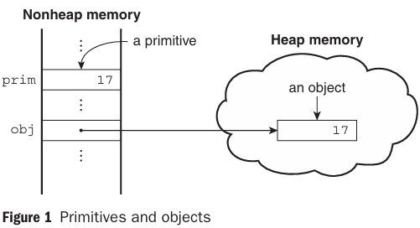
4 Primitives, Operations, and Expressions
4.1 Primitive Types
JavaScript has five primitive types: Number, String, Boolean, Undefined, and Null.
JavaScript includes predefined objects that are closely related to the Number, String, and Boolean types, named Number, String, and Boolean, respectively and they are called wrapper objects.
The purpose of the wrapper objects is to provide properties and methods that are convenient for use with values of the primitive types. In the case of Number, the properties are more useful; in the case of String, the methods are more useful.
The difference between primitives and objects is shown in the following example. Suppose that prim is a primitive variable with the value 17 and obj is a Number object whose property value is 17.

Slide 12
4.2 Numeric and String Literals
All numeric literals are primitive values of type Number.
The Number type values are represented internally in double-precision floating-point form.
Literal numbers in a script can have the forms of either integer or floating-point values.
72 7.2 .72 72. 7E2 7e2 .7e2 7.e2 7.2E-2
Integer literals can be written in hexadecimal form by preceding their first digit with either 0x or 0X.
A string literal is a sequence of zero or more characters delimited by either single quotes (') or double quotes (").
'You\'re the most freckly person I\'ve ever seen’
"D:\\bookfiles"

Slide 13
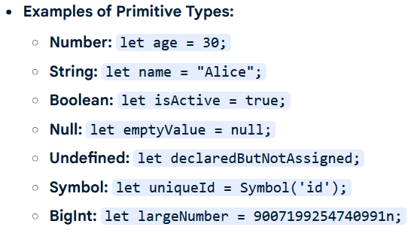
4.3 Other Primitive Types
The only value of type Null is the reserved word null, which indicates no value. A variable is null if it has not been explicitly declared or assigned a value.
Causes runtime error if it is used.
The only value of type Undefined is undefined. Unlike null, there is no reserved word undefined. If a variable has been explicitly declared, but not assigned a value, it has the value undefined. If the value of an undefined variable is displayed, the word undefined is displayed.
The only values of type Boolean are true and false.

Slide 14
4.4 Declaring Variables
One of the characteristics of JavaScript that sets it apart from most common non scripting programming languages is that it is dynamically typed.
The type of the value of a particular appearance of a variable in a program can be determined by the interpreter.
A variable can be declared either by assigning it a value, in which case the interpreter implicitly declares it to be a variable, or by listing it in a declaration statement that begins with the reserved word var.
var counter,
index,
pi = 3.14159265,
quarterback = "Elway",
stop_flag = true;

Slide 15
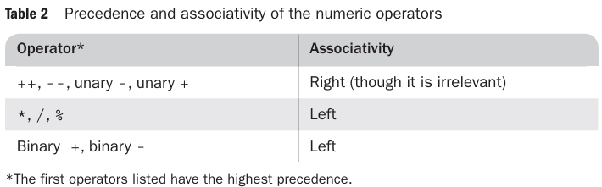
4.5 Numeric Operators
JavaScript has the typical collection of numeric operators: the binary operators + for addition, - for subtraction, * for multiplication, / for division, and % for modulus.
The unary operators are plus (+), negate (-), decrement (--), and increment (++).
The associativity rules of a language specify which operator is evaluated first when two operators with the same precedence are adjacent in an expression.

Slide 16
4.6 The Math Object
The Math object provides a collection of properties of Number objects and methods that operate on Number objects.
The Math object has methods for the trigonometric functions, such as sin (for sine) and cos (for cosine), as well as for other commonly used mathematical operations.
Among these are floor, to truncate a number; round, to round a number; and max, to return the largest of two given numbers.
Math.sin(x)

Slide 17
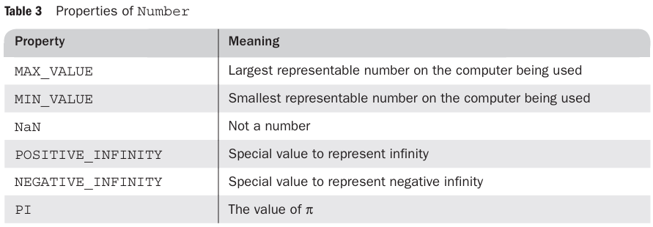
4.7 The Number Object
The Number object includes a collection of useful properties that have constant values.
var price = 427,
str_price;
. . .
str_price = price.toString();

Slide 18
4.8 The String Catenation Operator
JavaScript strings are not stored or treated as arrays of characters; rather, they are unit scalar values.
String catenation is specified with the operator denoted by a plus sign (+).
first + " Freeloader"
4.9 Implicit Type Conversions
The JavaScript interpreter performs several different implicit type conversions. Such conversions are called coercions.
If either operand of a + operator is a string, the operator is interpreted as a string catenation operator.
"August " + 1977
7 * "3"

Slide 19
4.10 Explicit Type Conversions
There are several different ways to force type conversions, primarily between strings and numbers.
Strings that contain numbers can be converted to numbers with the String constructor
Ex1:
var str_value = String(value);
Ex2:
var num = 6;
var str_value = num.toString(); //”6”
var str_value_binary = num.toString(2); //”110”
A number also can be converted to a string by catenating it with the empty string.
Strings can be explicitly converted to numbers in several different ways.
var number = Number(aString);
var number = aString - 0;
The two, parseInt and parseFloat, are not String methods, so they are not called through String objects.

Slide 20
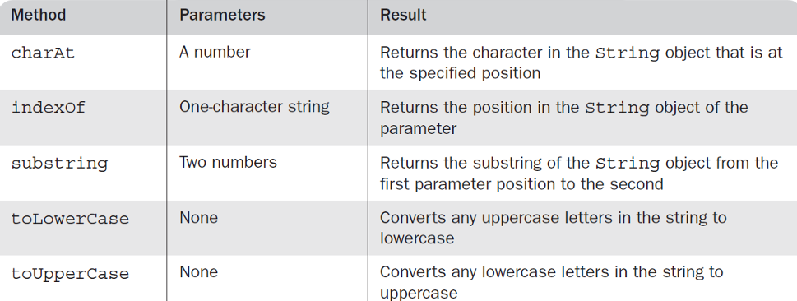
4.11 String Properties and Methods
String methods can always be used through String primitive values, as if the values were objects because of coercion
length property: gives number of characters in a string
String Methods:
var str = "George";
str.charAt(2) is 'o'
str.indexOf('r') is 3
str.substring(2, 4) is 'org'
str.toLowerCase() is 'george'

Slide 21
4.12 The typeof Operator
returns the type of its single operand
produces " number","string ", or “boolean” if the operand is of primitive type Number, String, or Boolean, respectively
If the operand is an object or null, typeof produces "object“=>Objects do not have types
If the operand is a variable that has not been assigned a value, typeof produces "undefined", reflecting the fact that variables themselves are not typed
typeof operator always returns a string
typeof operator always returns a string x and typeof (x) are equivalent

Slide 22
4.13 Assignment Statements
There is a simple assignment operator, denoted by =, and a host of compound assignment operators, such as += and /=.
a += 7;
a = a + 7;

Slide 23
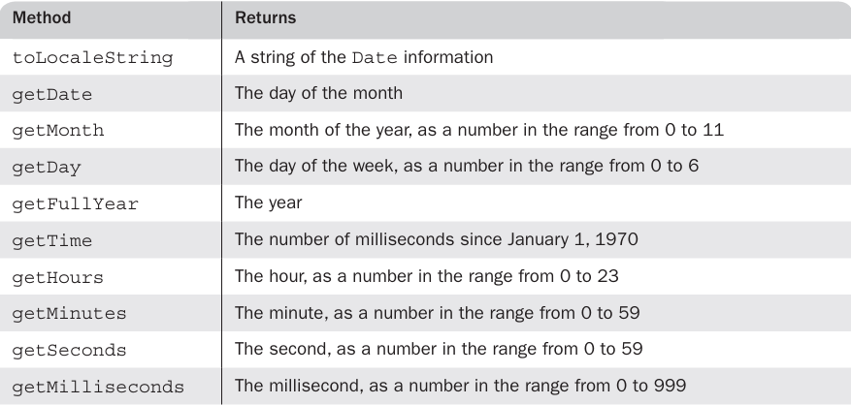
4.14 The Date Object
There are occasions when information about the current date and time is useful in a program.
A Date object is created with the new operator and the Date constructor, which has several forms.
var today = new Date();

Slide 24
5 Screen Output and Keyboard Input
A JavaScript script is interpreted when the browser finds the script or a reference to a separate script file in the body of the HTML document.
Thus, the normal output screen for JavaScript is the same as the screen in which the content of the host HTML document is displayed.
JavaScript models the HTML document with the Document object.
The window in which the browser displays an HTML document is modeled with the Window object.
The Window object includes two properties, document and window.
The Document object has several properties and methods. The most interesting and useful of its methods, is write, which is used to create output, which is dynamically created HTML document content.
document.write("The result is: ", result, "<br />");

Slide 25
write is used to create markup
The writeln method implicitly adds "\n" to its parameter
The parameter of write can include any HTML tags and content. The parameter is simply given to the browser, which treats it exactly like any other part of the HTML document.
the Window object is the JavaScript model for the browser window. Window includes three methods that create dialog boxes for three specific kinds of user interactions:
alert
prompt
confirm

Slide 26
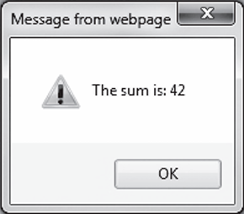
alert method:
The alert method opens a dialog window and displays its parameter in that window.
It also displays an OK button.
The string parameter of alert is not HTML code; it is plain text. Therefore, the string parameter of alert may include \n but never should include <br />.
alert("The sum is:" + sum + "\n");

Slide 27
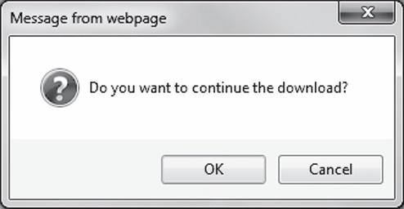
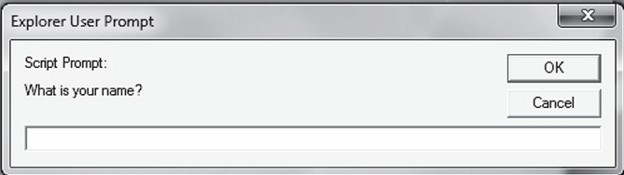
confirm method…
The confirm method opens a dialog window in which the method displays its string parameter, along with two buttons: OK and Cancel.
confirm returns a Boolean value that indicates the user’s button input: true for OK and false for Cancel.
var question = confirm("Do you want to continue this download?");
prompt method…
The prompt method creates a dialog window that contains a text box used to collect a string of input from the user, which prompt returns as its value.
As with confirm, this window also includes two buttons: OK and Cancel.
name = prompt("What is your name?", "");

Slide 28
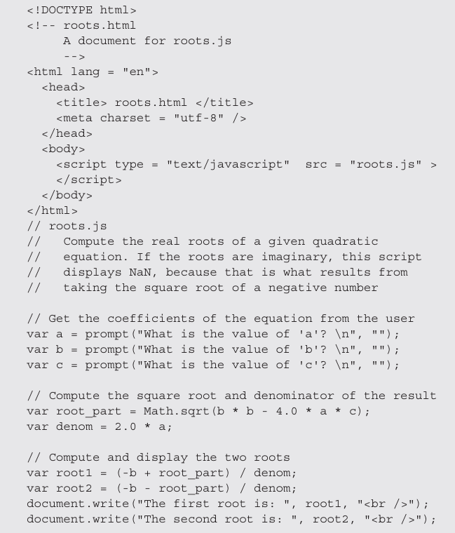

Slide 29
6 Control Statements
which provide the basis for controlling the order of execution of statements.
Control statements often require some syntactic container for sequences of statements whose execution they are meant to control.
A compound statement in JavaScript is a sequence of statements delimited by braces.
A control construct is a control statement together with the statement or compound statement whose execution it controls.
Unlike several related languages, JavaScript does not allow compound statements to create local variables.

Slide 30
6.1 Control Expressions
The expressions upon which statement flow control can be based include primitive values, relational expressions, and compound expressions.
The result of evaluating a control expression is one of the Boolean values true and false.
If the value of a control expression is a string, it is interpreted as true unless it is either the empty
string ("") or a zero string ("0").
If the value is a number, it is true unless it is zero (0).
If the special value, NaN, is interpreted as a Boolean, it is false.
If undefined is used as a Boolean, it is false.
When interpreted as a Boolean, null is false.
When interpreted as a number, true has the value 1 and false has the value 0.

Slide 31
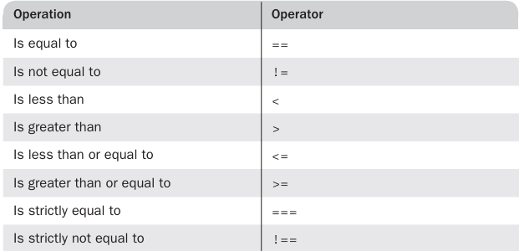
Control Statements continued…
A relational expression has two operands and one relational operator.
The last two operators in Table disallow type conversion of either operand. Thus, the expression "3" === 3 evaluates to false, while "3" == 3 evaluates to true.

Slide 32
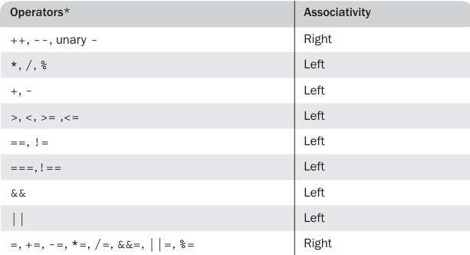
Operator precedence and associativity

Slide 33
6.2 Selection Statements
The selection statements (if-then and if-then-else) of JavaScript are similar to those of the common programming languages. Either single statements or compound statements can be selected
if (a > b)
document.write("a is greater than b <br />");
else {
a = b;
document.write("a was not greater than b <br />",
"Now they are equal <br />");
}

Slide 34
6.3 The switch Statement
JavaScript has a switch statement that is similar to that of Java.
switch (expression) {
case value_1:
//
statement(s)
case value_2:
//
statement(s)
. . .
[default:
//
statement(s)]
}
A break statement appears as the last statement in each sequence of statements following a case.

Slide 35
6.4 Loop Statements
The JavaScript while and for statements are similar to those of Java and C++.
while (control expression)
statement or compound statement
for (initial expression; control expression; increment expression)
statement or compound statement
do statement or compound statement
while (control expression)

Slide 36
7 Object Creation and Modification
Objects are often created with a new expression, which must include a call to a constructor method.
The constructor that is called in the new expression creates the properties that characterize the new object.
In JavaScript, however, the new operator creates a blank object—that is, one with no properties.
var my_object = new Object();
In this case, the constructor called is that of Object, which endows the new object with no properties
The variable my_object references the new object. Calls to constructors must include parentheses, even if there are no parameters.

Slide 37
The number of members of a class in Java or C++ is fixed at compile time.
The number of properties in a JavaScript object is dynamic.
At any time during interpretation, properties can be added to or deleted from an object.
A property for an object is created by assigning a value to that property’s name.
// Create an Object object
var my_car = new Object();
// Create and initialize the make property
my_car.make = "Ford";
// Create and initialize model
my_car.model = "Fusion";
There is an abbreviated way to create an object and its properties.
var my_car = {make: "Ford", model: "Fusion"};

Slide 38
Because objects can be nested, you can create a new object that is a property of my_car with properties of its own, as in the following statements:
my_car.engine = new Object();
my_car.engine.config = "V6";
my_car.engine.hp = 263;
Properties can be accessed in two ways.
var prop1 = my_car.make;
var prop2 = my_car["make"];
If an attempt is made to access a property of an object that does not exist, the value undefined is used.
A property can be deleted with delete
delete my_car.model;
JavaScript has a loop statement, for-in, that is perfect for listing the properties of an object
for (var prop in my_car)
document.write("Name: ", prop, "; Value: ", my_car[prop], "<br />");

Slide 39
8 Arrays
In JavaScript, arrays are objects that have some special functionality.
Array elements can be primitive values or references to other objects, including other arrays.
8.1 Array Object Creation
Array objects, unlike most other JavaScript objects, can be created in two distinct ways.
The usual way to create any object is with the new operator and a call to a constructor.
var my_list = new Array(1, 2, "three", "four");
var your_list = new Array(100);
The second way to create an Array object is with a literal array value, which is a list of values enclosed in brackets:
var my_list_2 = [1, 2, "three", "four"];

Slide 40
8.2 Characteristics of Array Objects
The lowest index of every JavaScript array is zero.
Access to the elements of an array is specified with numeric subscript expressions placed in brackets.
The length of an array is the highest subscript to which a value has been assigned, plus 1.
the length of an array can be set to whatever you like by assigning the length property,
my_list.length = 1002;

Slide 41
8.3 Array Methods
The join method converts all of the elements of an array to strings and catenates them into a single string.
If no parameter is provided to join, the values in the new string are separated by commas.
If a string parameter is provided, it is used as the element separator.
var names = new Array["Mary", "Murray", "Murphy", "Max"];
. . .
var name_string = names.join(" : ");
The value of name_string is now "Mary : Murray : Murphy : Max".
The reverse method reverses the order of the elements of the Array object through which it is called.
The sort method coerces the elements of the array to become strings if they are not already strings and sorts them alphabetically.
names.sort();
The concat method catenates its actual parameters to the end of the Array object on which it is called.
var names = new Array["Mary", "Murray", "Murphy", "Max"];
. . .
var new_names = names.concat("Moo", "Meow");

Slide 42
Array methods continued…
The slice method does for arrays what the substring method does for strings, returning the part of the Array object specified by its parameters, which are used as subscripts.
var list = [2, 4, 6, 8, 10];
. . .
var list2 = list.slice(1, 3);
list2 is now [4, 6].
If slice is given just one parameter, the array that is returned has all of the elements of the object, starting with the specified index.
When the toString method is called through an Array object, each of the elements of the object is converted (if necessary) to a string.
The push, pop, unshift, and shift methods of Array allow the easy implementation of stacks and queues in arrays.
var list = ["Dasher", "Dancer", "Donner", "Blitzen"];
var deer = list.pop(); // deer is "Blitzen"
list.push("Blitzen");

Slide 43
A two-dimensional array is implemented in JavaScript as an array of arrays. This can be done with the new operator or with nested array literals
// nested_arrays.js
// An example illustrating an array of arrays
// Create an array object with three arrays as its elements
var nested_array = [[2, 4, 6], [1, 3, 5], [10, 20, 30]];
// Display the elements of nested_list
for (var row = 0; row <= 2; row++) {
document.write("Row ", row, ": ");
for (var col = 0; col <=2; col++)
document.write(nested_array[row][col], " ");
document.write("<br />");
}

Slide 44
9 Functions
9.1 Fundamentals
A function definition consists of the function’s header and a compound statement that describes the actions of the function. This compound statement is called the body of the function.
A function header consists of the reserved word function, the function’s name, and a parenthesized list of parameters if there are any.
The parentheses are required even if there are no parameters.
A return statement returns control from the function in which it appears to the function’s caller.
Syntactically, a call to a function with no parameters states the function’s name followed by an empty pair of parentheses.

Slide 45
JavaScript functions are objects, so variables that reference them can be treated as are other object references—they can be passed as parameters, be assigned to other variables, and be the elements of an array.
function fun() {
document.write("This surely is fun! <br/>");
}
ref_fun = fun; // Now, ref_fun refers to the fun object
fun(); // A call to fun
ref_fun(); // Also a call to fun
To ensure that the interpreter sees the definition of a function before it sees a call to the function—a requirement in JavaScript—function definitions are placed in the head of an HTML document
Normally, but not always, calls to functions appear in the document body.

Slide 46
9.2 Local Variables
The scope of a variable is the range of statements over which it is visible.
When JavaScript is embedded in an HTML document, the scope of a variable is the range of lines of the document over which the variable is visible.
A variable that is not declared with a var statement is implicitly declared by the JavaScript interpreter at the time it is first encountered in the script.
Variables that are implicitly declared have global scope—that is, they are visible in the entire HTML document
Variables that are explicitly declared outside function definitions also have global scope.
It is usually best for variables that are used only within a function to have local scope
If a variable that is defined both as a local variable and as a global variable appears in a function, the local variable has precedence, effectively hiding the global variable with the same name.

Slide 47
9.3 Parameters
The parameter values that appear in a call to a function are called actual parameters.
The parameter names that appear in the header of a function definition, which correspond to the actual parameters in calls to the function, are called formal parameters.
JavaScript uses the pass-by-value parameter-passing method. When a function is called, the values of the actual parameters specified in the call are, in effect, copied into their corresponding formal parameters, which behave exactly like local variables.
Because references are passed as the actual parameters of objects, the called function has access to the objects and can change them, thereby providing the semantics of pass-by-reference parameters.
However, if a reference to an object is passed to a function and the function changes its corresponding formal parameter then the change has no effect on the actual parameter.

Slide 48
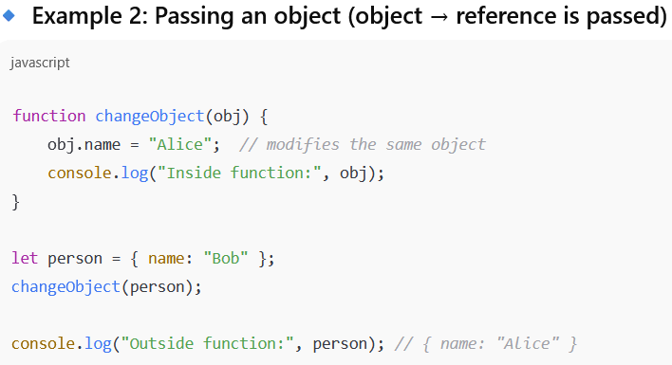
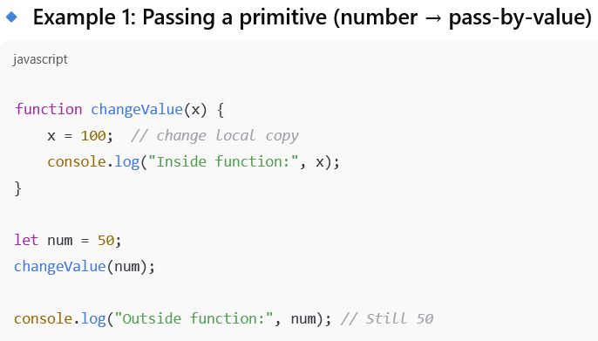
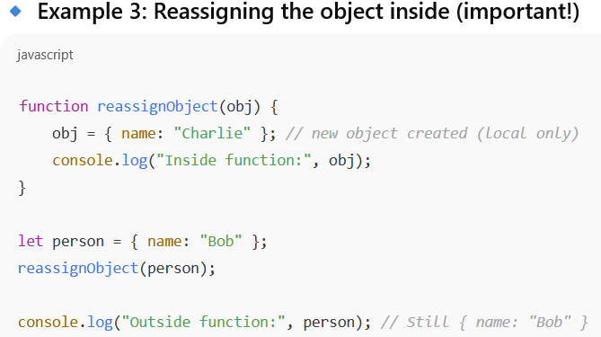
Example

Slide 49
Continued…
All parameters are communicated through a property array, arguments, that, like other array objects, has a property named length.
By accessing arguments.length, a function can determine the number of actual parameters that were passed.
function params(a, b) {
document.write("Function params was passed ", arguments.length, " parameter(s) <br />");
document.write("Parameter values are: <br />");
document.write("<br />");
}
for (var arg = 0; arg < arguments.length; arg++)
document.write(arguments[arg], "<br />");
// A test driver for function params
params("Mozart");
params("Mozart", "Beethoven");
params("Mozart", "Beethoven", "Tchaikowsky");

Slide 50
9.4 The sort Method, Revisited
sort method for array objects converts the array’s elements to strings, if necessary, and then sorts them alphabetically
If we need to sort something other than strings, or if you want an array to be sorted in some order other than alphabetically as strings, the comparison operation must be supplied to the sort method by the caller
Such a comparison operation is passed as a parameter to sort
The comparison function must return a negative number if the two elements being compared are in the desired order, zero if they are equal, and a number greater than zero if they must be interchanged
function my_order ( a,b ){return a-b;}
array.sort ( my_order )
Rather than defining a comparison function elsewhere and passing its name, the function definition can appear as the actual parameter in the call to sort
array.sort (function(a, b){return a-b};)

Slide 51
11 Constructors
JavaScript constructors are special functions that create and initialize the proper ties of newly created objects.
Every new expression must include a call to a constructor whose name is the same as that of the object being created.
this variable is used to construct and initialize the properties of the object
function car(new_make, new_model, new_year) {
this.make = new_make;
this.model = new_model;
this.year = new_year;
}
my_car = new car("Ford", "Fusion", "2012");
If a method is to be included in the object, it is initialized the same way as if it were a data property.
function display_car() {
document.write("Car make: ", this.make, "<br/>");
document.write("Car model: ", this.model, "<br/>");
document.write("Car year: ", this.year, "<br/>");
}
this.display = display_car;

Slide 52
12 Pattern Matching by Using Regular Expressions
There are two approaches to pattern matching in JavaScript: one that is based on the methods of the RegExp object and one that is based on methods of the String object.
patterns are specified in a form that is based on regular expressions, which were developed to define members of a simple class of formal languages.
Elaborate and complex patterns can be used to describe specific strings or categories of strings.
Patterns, which are sent as parameters to the pattern matching methods, are delimited with slashes.
The simplest pattern-matching method is search, which takes a pattern as a parameter.
The search method returns the position in the String object at which the pattern matched.
If there is no match, search returns –1.
var str = "Rabbits are furry";
var position = str.search(/bits/);
if (position >= 0)
document.write("'bits' appears in position", position,"<br />");
else
document.write("'bits' does not appear in str <br />");
Ans:
'bits' appears in position 3

Slide 53
12.1 Character and Character-Class Patterns
Metacharacters are characters that have special meanings in some contexts in patterns.
\ | ( ) [ ] { } ^ $ * + ? .
Metacharacters can themselves be matched by being immediately preceded by a backslash.
A period matches any character except newline. So, the following pattern matches "snowy", "snowe", and "snowd", among others:
/snow./
To match a period in a string, the period must be preceded by a backslash in the pattern. For example, the pattern /3\.4/ matches 3.4. The pattern / 3.4/ matches 3.4 and 374, among others.
It is often convenient to be able to specify classes of characters rather than individual characters. Such classes are defined by placing the desired characters in brackets.
Example: [abc]
[a-h]

Slide 54
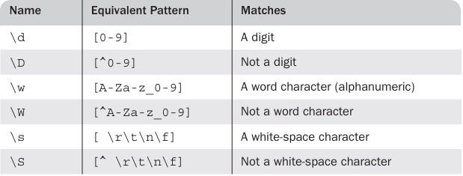
If a circumflex character (^) is the first character in a class, it inverts the specified set.
[^aeiou]
some character classes are predefined and named and can be specified by their names
/\d\.\d\d/ // Matches a digit, followed by a period, followed by two digits
/\D\d\D/ // Matches a single digit
/\w\w\w/ // Matches three adjacent word characters

Slide 55
/xy{4}z/ - matches xyyyyz
There are also three symbolic quantifiers: asterisk (*), plus (+), and question mark (?).
An asterisk means zero or more repetitions, a plus sign means one or more repetitions, and a question mark means one or none.
/x*y+z?/
The quantifiers are often used with the predefined character-class names
/\d+\.\d*/ - matches 99999.999
/[A-Za-z]\w*/ - matches the identifiers (a letter, followed by zero or more letters, digits, or under scores)
There is one additional named pattern that is often useful: \b (boundary), which matches the boundary position between a word character (\w) and a non word character (\W), in either order.
"A tulip is a flower" but not "A frog isn’t”:
/\bis\b/ - recognize the is but isn’t is not recognized

Slide 56
12.2 Anchors
It is useful to be able to specify that a pattern must match at a particular position in a string i.e. first or last.
A pattern can be specified to match only at the beginning of the string by preceding it with a circumflex (^) anchor.
For example, the following pattern matches "pearls are pretty" but does not match "My pearls are pretty“
/^pearl/
A pattern can be specified to match at the end of a string only by following the pattern with a dollar sign anchor.
For example, the following pattern matches "I like gold" but does not match "golden":
/gold$/

Slide 57
12.3 Pattern Modifiers
Modifiers can be attached to patterns to change how they are used, thereby increasing their flexibility. The modifiers are specified as letters just after the right delimiter of the pattern.
The i modifier makes the letters in the pattern match either uppercase or lowercase letters in the string.
For example, the pattern /Apple/i matches ‘APPLE’, ‘apple’, ‘APPle’, and any other combination of uppercase and lowercase spellings of the word “apple.”
The x modifier allows white space to appear in the pattern.
/\d+ # The street number
\s # The space before the street name
[A-Z][a-z]+ # The street name
/x
is equivalent to
/\d+\s[A-Z][a-z]+/

Slide 58
12.4 Other Pattern-Matching Methods of String
The replace method is used to replace substrings of the String object that match the given pattern.
The replace method takes two parameters: the pattern and the replacement string.
The g modifier can be attached to the pattern if the replacement is to be global in the string.
var str = "Fred, Freddie, and Frederica were siblings";
str.replace(/Fre/g, "Boy");
The match method is the most general of the String pattern-matching methods.
The match method takes a single parameter: a pattern. It returns an array of the results of the pattern-matching operation.
var str = "Having 4 apples is better than having 3 oranges";
var matches = str.match(/\d/g);
In this example, matches is set to [4, 3].

Slide 59
The split method of String splits its object string into substrings on the basis of a given string or pattern. The substrings are returned in an array. For example, consider the following code:
var str = "grapes:apples:oranges";
var fruit = str.split(":");
In this example, fruit is set to [grapes, apples, oranges].

Slide 60

Example:
function tst_phone_num(num) {
// Use a simple pattern to check the number of digits and the dash
var ok = num.search(/^\d{3}-\d{4}$/);
if (ok == 0)
return true;
else
return false;
} // end of function tst_phone_num
// A script to test tst_phone_num
var tst = tst_phone_num("444-5432");
if (tst)
document.write("444-5432 is a valid phone number <br />");
else
document.write("Error in tst_phone_num <br />");
tst = tst_phone_num("444-r432");
if (tst)
document.write("Program error <br />");
else
document.write( "444-r432 is not a valid phone number <br />");
tst = tst_phone_num("44-1234");
if (tst)
document.write("Program error <br />");
else
document.write("44-1234 is not a valid phone number <br /");

Slide 61
Dynamic Object Model (DOM)

Slide 62
1 The JavaScript Execution Environment
The JavaScript Window object represents the browser window where the document is shown.
All variables in JavaScript are actually properties of some object.
The properties of the Window object are accessible to all JavaScript code, whether it is written inside the HTML file or in an external file. These properties include all global variables.
When a global variable is declared in client-side JavaScript, it automatically becomes a property of the Window object. This makes the Window object the main environment for all JavaScript execution.
The Document object represents the HTML page that is displayed in the browser.
Each Window object contains a property called document, which refers to the Document object being shown.
The Document object has a forms array, where each element represents a form present in the document.
Each form in this array contains an elements array, which includes objects representing form elements like buttons, input fields, and menus.

Slide 63
2 The Document Object Model
The DOM is an application programming interface (API) that defines an interface between HTML documents and application programs.
Each language that interfaces with the DOM must define a binding to that inter face.
The actual DOM specification consists of a collection of interfaces, including one for each document tree node type.
They define the objects, methods, and properties that are associated with their respective node types.
With the DOM, users can write code in programming languages to create documents, move around in their structures, and change, add, or delete elements and their content.
Documents in the DOM have a treelike structure, but there can be more than one tree in a document

Slide 64
Title
A language that is designed to support the DOM must have a binding to the DOM constructs.
This binding amounts to a correspondence between constructs in the language and elements in the DOM.
In the JavaScript binding to the DOM, the elements of a document are objects, with both data and operations.
The data are called properties, and the operations are, naturally, called methods.
For example, the following HTML element would be represented as an object with two properties, type and name, with the values "text" and "address", respectively
<input type = "text" name = "address">

Slide 65
Title
IE8+, FX3, and C10+ provide a way of viewing the DOM structure of a displayed document.
After displaying a document with IE9, select Tools/Developer Tools. The lower-left area of the resulting display will show an elided version of the DOM structure.
To be able to display the DOM structure of a document with FX3, an add on must be downloaded.
addOn - “ https://addons .mozilla.org/en-US/firefox/addon/6622”

Slide 66
3 Element Access in JavaScript
The elements of an HTML document have corresponding objects that are visible to an embedded JavaScript script.
There are several ways the object associated with a form element can be addressed in JavaScript
The original (DOM 0) way is to use the forms and elements arrays of the Document object, which is referenced through the document property of the Window object.
<html lang = "en">
<head>
<title> Access to form elements </title>
<meta charset = "utf-8" />
</head>
<body>
<form action = "">
<input type = "button" name = "turnItOn" />
</form>
</body>
</html>
var dom = document.forms[0].elements[0];

Slide 67
Continued…
Another approach to DOM addressing is to use element names. For this, the element and its enclosing elements, up to but not including the body element, must include name attributes
<html lang = "en">
<head>
<title> Access to form elements </title>
<meta charset = "utf-8" />
</head>
<body>
<form name = "myForm" action = "">
<input type = "button" name = "turnItOn" />
</form>
</body>
</html>
var dom = document.myForm.turnItOn;
One minor drawback of this approach is that the XHTML 1.1 standard does not allow the name attribute in the form element, even though the attribute is now valid for form elements.

Slide 68
Continued…
Yet another approach to element addressing is to use the JavaScript method getElementById,
var dom = document.getElementById("turnItOn");
Because ids are useful for DOM addressing and names are required for form processing code, form elements often have both ids and names, set to the same value.
Buttons in a group of checkboxes often share the same name. The buttons in a radio button group always have the same name.
In these cases, the names of the individual buttons obviously cannot be used in their DOM addresses.
Of course, each radio button and checkbox can have an id, which would make them easy to address by using getElementById.
However, this approach does not provide a convenient way to search a group of radio buttons or checkboxes to determine which is checked.

Slide 69
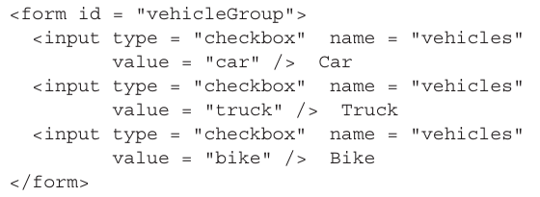
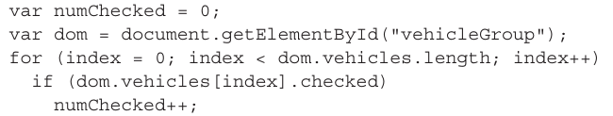
Continued…
An alternative to both names and ids is provided by the implicit arrays associated with each checkbox and radio button group.
Every such group has an array, which has the same name as the group name, that stores the DOM addresses of the individual buttons in the group.
These arrays are properties of the form in which the buttons appear. To access the arrays, the DOM address of the form object must first be obtained
the following code counts the number of checkboxes that were checked

Slide 70
4 Events and Event Handling
4.1 Basic Concepts of Event Handling
One important use of JavaScript for Web programming is to detect certain activities of the browser and the browser user and provide computation when those activities occur.
These computations are specified with a special form of programming called event-driven programming.
In event-driven programming, parts of the program are executed at completely unpredictable times, often triggered by user interactions with the program that is executing.
An event is a notification that something specific has occurred, either in the browser, such as the completion of the loading of a document, or a browser user action, such as a mouse click on a form button.
An event handler is a script that is implicitly executed in response to the appearance of an event.

Slide 71
Continued…
Events are created by activities associated with specific HTML elements.
For example, the click event can be caused by the browser user clicking a radio button or the link of an anchor tag, among other things.
The process of connecting an event handler to an event is called registration.
There are two distinct approaches to event handler registration, one that assigns tag attributes and one that assigns handler addresses to object properties.
The write method of document should never be used in an event handler.

Slide 72
4.2 Events, Attributes, and Tags
HTML4 defined a collection of events that browsers implement and with which JavaScript can deal.
These events are associated with HTML tag attributes, which can be used to connect the events to handlers.
The attributes have names that are closely related to their associated events.
The same attribute can appear in several different tags .

Slide 73
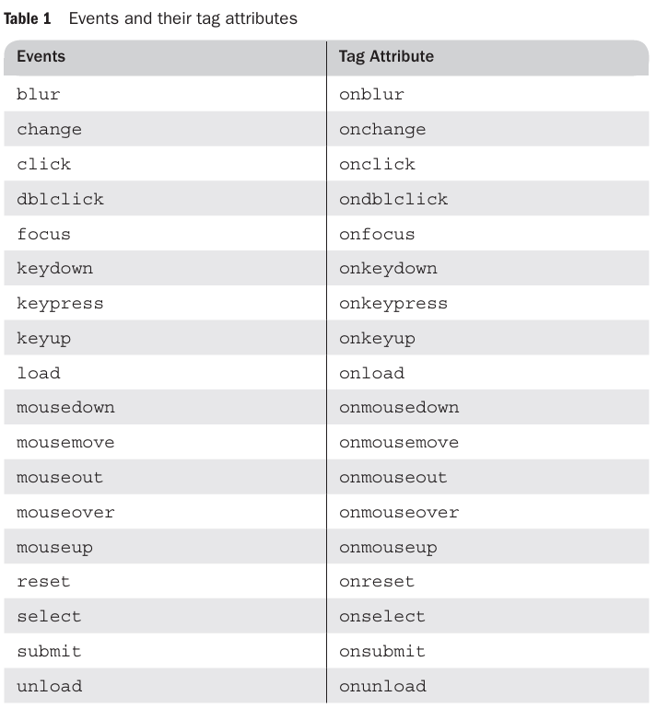
Continued…
Events and their tag attributes

Slide 74
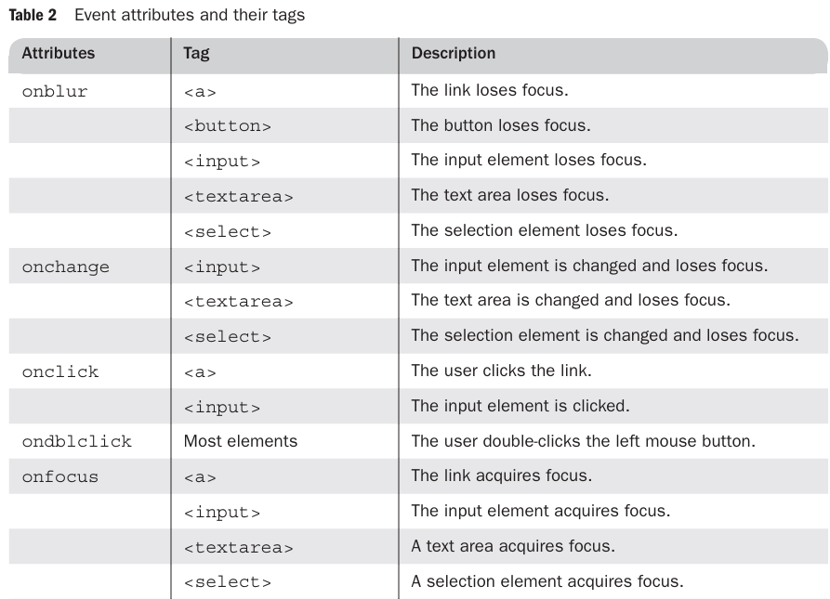
Continued…
Table 2 shows (1) the most commonly used attributes related to events, (2) tags that can include the attributes, and (3) the circumstances under which the associated events are created.

Slide 75
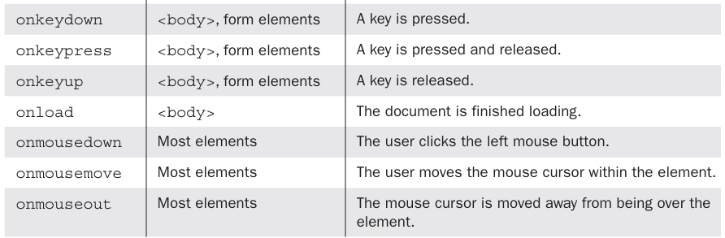
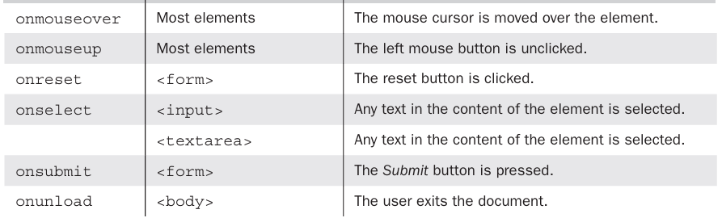
Continued…

Slide 76
Event Registration
Assigning the event handler script to an event tag attribute
<input type = "button" id = "myButton"
onclick = "alert('You clicked my button!');" />
If the handler consists of more than a single statement, a function is used
<input type = "button" id = "myButton"
onclick = "myButtonHandler();" />
An event handler function could also be registered by assigning its name to the associated event property on the button object
document.getElementById("myButton").onclick = myButtonHandler;

Slide 77
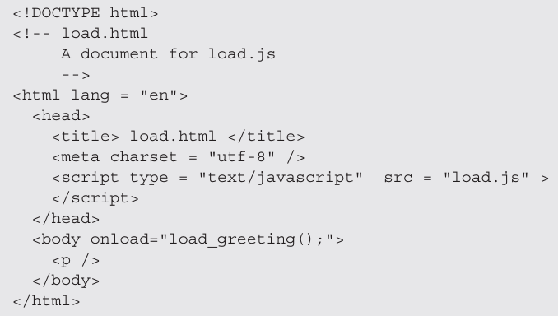
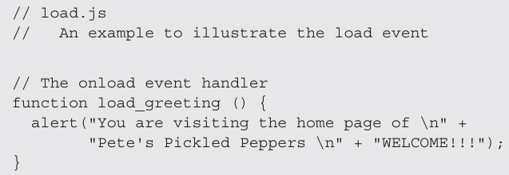
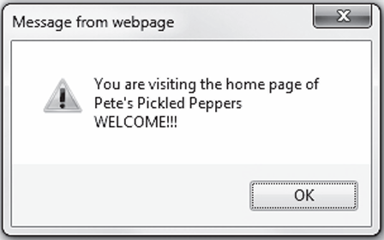
5 Handling Events from Body Elements
The events most often created by body elements are load and unload.
Ex: consider the simple case of producing an alert message when the body of the document has been loaded.
The unload event is probably more useful than the load event.
It is used to do some cleanup before a document is unloaded, as when the browser user goes on to some new document.
For example, if the document opened a second browser window, that window could be closed by an unload event handler.

Slide 78
6 Handling Events from Button Elements
Buttons in a Web document provide an effective way to collect simple input from the browser user. The most commonly used event created by button actions is click.
<!DOCTYPE html>
<!-- radio_click.hmtl
A document for radio_click.js Creates four radio buttons that call the planeChoice event handler to display descriptions
-->
<html lang = "en">
<head>
<title> radio_click.html </title>
<meta charset = "utf-8" />
<script type = "text/javascript" src = "radio_click.js" > </script>
</head>
<body>
<h4> Cessna single-engine airplane descriptions </h4>
<form id = "myForm" action = "">
<p>
<label> <input type = "radio" name = "planeButton“ value = "152" onclick = "planeChoice(152)" /> Model 152 </labe><br />
<label> <input type = "radio" name = "planeButton" value = "172“ onclick = "planeChoice(172)" />Model 172 (Skyhawk) </label><br />
<label> <input type = "radio" name = "planeButton" value = "182“ onclick = "planeChoice(182)" /> Model 182 (Skylane) </label> <br />
<label> <input type = "radio" name = "planeButton" value = "210" onclick = "planeChoice(210)" /> Model 210 (Centurian) </label> </p>
</form>
</body>
</html>

Slide 79
Continued…
// radio_click.js
// An example of the use of the click event with radio buttons,
// registering the event handler by assignment to the button
// attributes
// The event handler for a radio button collection
function planeChoice (plane) {
// Produce an alert message about the chosen airplane
switch (plane) {
case 152:
alert("A small two-place airplane for flight training");
break;
case 172:
alert("The smaller of two four-place airplanes");
break;
case 182:
alert("The larger of two four-place airplanes");
break;
case 210:
alert("A six-place high-performance airplane");
break;
default:
alert("Error in JavaScript function planeChoice");
break;
}
}

Slide 80
Continued…
Approach2: assigning an event handler function’s name to the associated event property on the object
document.getElementById (" myButton").onclick = myButtonHandler ;
This statement must follow both the handler function and the form element so that JavaScript has seen both before assigning the property

Slide 81
7 Handling Events from Text Box and Password Elements
Text boxes and passwords can create four different events: blur, focus, change, and select.
An HTML element is said to get focus when the user puts the mouse cursor over it and clicks the left mouse button. An element can also get focus when the user tabs to the element. When a text element has focus, any keyboard input goes into that element. Only one text element can have focus at onetime
An element becomes blurred when the user moves the cursor away from the element and clicks the left mouse button or when the user tabs away from the element

Slide 82
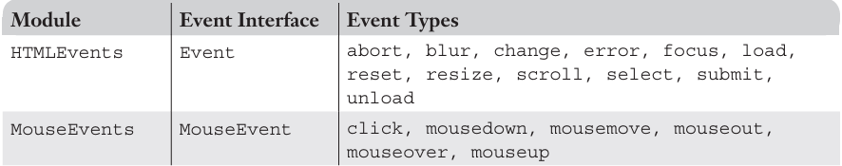
THE DOM 2 EVENT MODEL
The DOM 2 model is a modularized interface. One of the DOM 2 modules is Events, which includes several submodules.
The ones most commonly used are HTMLEvents and MouseEvents.
When an event occurs and an event handler is called, an object that implements the event interface associated with the event type is implicitly passed to the handler.

Slide 83
8.1 Event Propagation
The connection between an event and the handler that deals with it is very simple in the DOM 0 event model.
When the browser senses that an event has occurred, the object associated with the element that caused the event is checked for event handlers.
If that object has a registered handler for the particular event that occurred, that handler is executed.

Slide 84
Continued…
In DOM2 An event object is created at some node in the document tree. For that event, that node is called the target node. Event creation causes a three-phase process to begin.
The first of these phases is called the capturing phase.
The event created at the target node starts at the document root node and propagates down the tree to the target node.
If there are any handlers for the event that are registered on any node encountered in this propagation, including the document node but not the target node, these handlers are checked to determine whether they are enabled.
Any enabled handler for the event that is found during capturing is executed.
When the event reaches the target node, the second phase, called the target node phase, takes place. In this phase, the handlers registered for the event at the target node are executed, regardless of whether they are enabled or not.
The process is similar to what happens with the DOM 0 event model.
After execution of any appropriate handlers at the target node, the third phase begins. This is the bubbling phase, in which the event bubbles back up the document tree to the document node.
On this trip back up the tree, any handler registered for the event at any node on the way is executed

Slide 85
Continued…
In a large and complicated document, having event handlers for every element would require a great deal of code.
Much of this code would be redundant, both in the handlers and in the registering of handlers for events.
Therefore, it was better to define a way for a single handler to deal with events created from a number of similar or related elements.
The concept involved is that events can be propagated to some central place for handling, rather than always being handled locally
In the DOM, the natural central place for event handling is at the document or window level, so that is the direction of bubbling.
Many events cause the browser to perform some action; for example, a mouse click on a link causes the document referenced in the link to replace the current document.
In some cases, we want to prevent this action from taking place.
For example, if a value in a form is found to be invalid by a Submit button event handler, we do not want the form to be submitted to the server. In the DOM 0 event model, the action is prevented by having the handler return false. The DOM 2 event interface provides a method, preventDefault, that accomplishes the same thing. Every event object implements preventDefault.

Slide 86
8.2 Event Handler Registration
The DOM 0 event model uses two different ways of registering event handlers.
First, the handler code can be assigned as a string literal to the event’s associated attribute in the element.
Second, the name of the handler function can be assigned to the property associated with the event.
Handler registration in the DOM 2 event model is performed by the method addEventListener, which is defined in the EventTarget interface, which is implemented by all objects that descend from Document.
The addEventListener method takes three parameters, the first of which is the name of the event as a string literal. For example, "mouseup" and "submit" would be legitimate first parameters.
The second parameter is the handler function, which could be specified as the function code itself or as the name of a function that is defined elsewhere. Note that this parameter is not a string type, so it is not quoted.
The third parameter is a Boolean value that specifies whether the handler is enabled for calling during the capturing phase.

Slide 87
Continued…
When a handler is called, it is passed a single parameter, the event object.
For example, suppose we want to register the event handler chkName on the text element whose id is custName for the change event.
document.custName.addEventListener("change", chkName, false);
The removeEventListener method deletes the registration of an event handler. This method takes the same parameters as addEventListener.
DOM2Example

Slide 88
11 DOM Tree Traversal and Modification
There are many objects, properties, and methods associated with DOM 2 document representations
One collection of these is defined in the Node interface, which is implemented by all node objects in the DOM structure.
Some can be used to traverse and modify the DOM tree structure of the document being displayed.

Slide 89
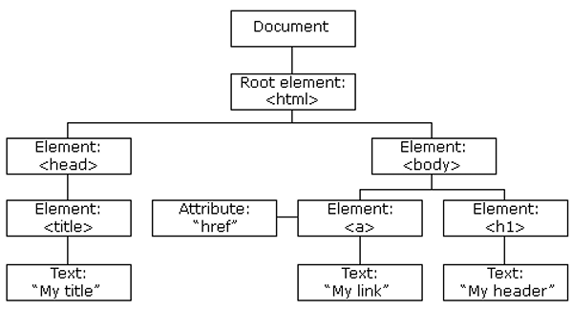
Continued…
According to the W3C HTML DOM standard, everything in an HTML document is a node:
The entire document is a document node
Every HTML element is an element node
The text inside HTML elements are text nodes
Every HTML attribute is an attribute node
All comments are comment nodes
With the HTML DOM, all nodes in the node
tree can be accessed by JavaScript

Slide 90
11.1 DOM Tree Traversal
The parentNode property has the DOM address of the parent node of the node through which it is referenced.
The childNodes property is an array of the child nodes of the node through which it is referenced.
For example, if the document has an unordered list with the id mylist, the number of items in the list can be displayed with the following code
var nod = document.getElementById("mylist");
var listitems = nod.childNodes.length;
document.write("Number of list items is: " + listitems + “ ");
The previousSibling property has the DOM address of the previous sibling node of the node through which it is referenced.
The nextSibling property has the DOM address of the next sibling node of the node through which it is referenced.
The firstChild and lastChild properties have the DOM addresses of the first and last child nodes, respectively, of the node through which they are referenced.
The nodeType property has the type of the node through which it is referenced.

Slide 91
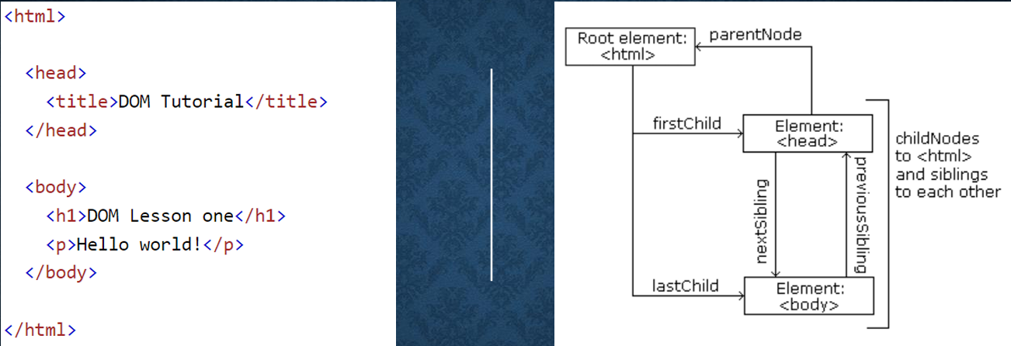
Title
Content

Slide 92
11.2 DOM Tree Modification
A number of methods allow JavaScript code to modify an existing DOM tree structure.
The insertBefore(newChild, refChild) method places the newChild node before the refChild node.
The replaceChild(newChild, oldChild) method replaces the oldChild node with the newChild node.
The removeChild(oldChild) method removes the specified node from the DOM structure.
The appendChild(newChild) method adds the given node to the end of the list of siblings of the node through which it is called.

Slide 93
Navigator Object
The Navigator object is a built-in JavaScript object.
It provides information about the browser used to view the webpage.
It is part of the Browser Object Model (BOM).
It is accessed using the navigator keyword.
navigator.appName returns the browser name.
navigator.appVersion returns the browser version.

Slide 94
